Slide 1

Topic: Syllogism

Slide 2
There are 3 relations in syllogism.
Definite relationship.
Either and OR
Possibility

Slide 3
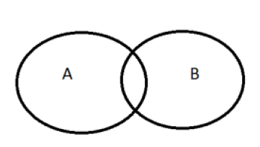
CONCEPT 1 Some A is B.
The Diagram for Some A is B is
There are 2 definite conclusions,
1) Some A is B
2) Some B is A

Slide 4
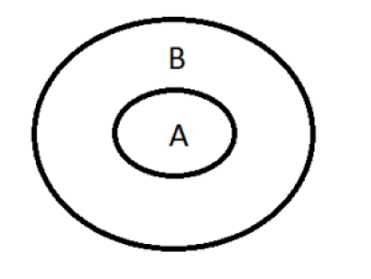
CONCEPT 2 – All A is B
There are 3 definite Conclusions,
All A is B.
Some A is B.
Some B is A.

Slide 5
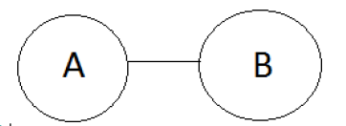
Concept 3 – No A is B
There are 4 definite Conclusions,
1) No A is B
2) No B is A
3) Some A is not B
4) Some B is not A

Slide 6
Concept 4 – Some A are not B
There are only 1 definite Conclusion,
1) Some A are not B.

Slide 7
Note-
Positive statement not lead to negative statement and vice-versa.
Some- Many/ Maximum/Minimum/ Most of them/ 99%/ 50%. These are called particular statement.
All- Any/Every/Each/100%/All that. These are called universal statement.

Slide 8
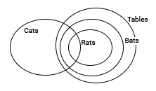
Statements: Some Cats are Rats.
All bats are tables.
All Rats are Bats.
Conclusion: I. Some Cats are bats
II. All bats are rats
III. All tables are cats
IV. All bats are cats
1. Only I & II follow
2. Only II follows
3. Only I & IV follow
4. None of these
Ans:4
Clearly, from the diagram Conclusion I is true. So option 4.

Slide 9
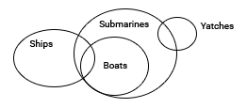
Statements: Some ships are boats. All boats are submarines. Some submarines are yatches. Conclusion:I. Some yatches are boats.
II. Some submarines are boats.
III. Some submarines are ships.
IV. Some yatches are ships
1. All follow
2. Only II and III follow
3. Only III follows
4. Only IV follows
Ans:2
From the diagram we can infer that some submarines are boats and some submarines are ships. So 2nd option.

Slide 10
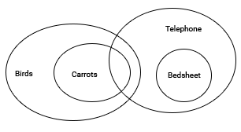
Statements: All Carrots are birds.
Some telephones are Carrots.
All bedsheets are telephone.
Conclusion:
I. All bedsheet are birds
II. Some bedsheet are birds
III. Some birds are telephone
IV. All telephone are birds
1. Only I follows
2. Only II follows
3. Only I and III follow
4. Only III follows
Ans:4
The diagram gives all the possibilities. But only conclusion III is true.

Slide 11
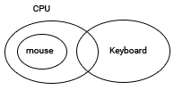
Statements: Most CPUs are keyboards. No keyboard is a Mouse. All Mouses are CPU. Conclusion:
I. Some keyboards are CPU
II. All CPU’s are Mouse
III. No Mouse is a keyboard
IV. Some Mouse are keyboard
1. Only I follows
2. Only II and III follow
3. Only I and III follow
4. Only II follows
Ans:3
Clearly from the diagram, I and III are true.

Slide 12
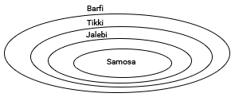
Statements: Samosas are Jalebi. All Jalebis are Tikki. All Tikkis are Barfi Conclusion:
I. All Jalebis are Barfi
II. All Tikkis are Samosas
III. All Samosas are Barfi
IV. All Barfi are Jalebi
1. Only I and II follow
2. Only I and III follow
3. Only II and III follow
4. All follow
Ans:2
Clearly from the diagram, I and III are true.

Slide 13
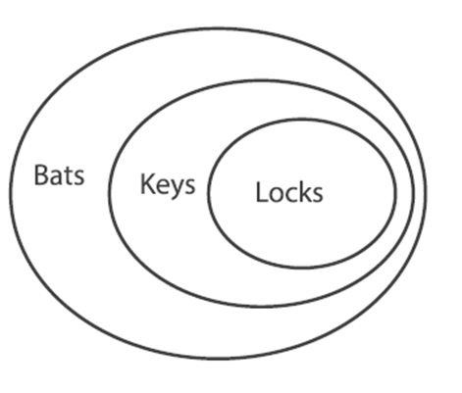
Statements: All locks are keys.
All keys are bats.
Conclusions:
I. Some bats are locks.
II. Some locks are keys.
if only conclusion I follows.
if only conclusion II follows.
if both conclusions I & II follow.
if no conclusion follows.
Ans: 3

Slide 14
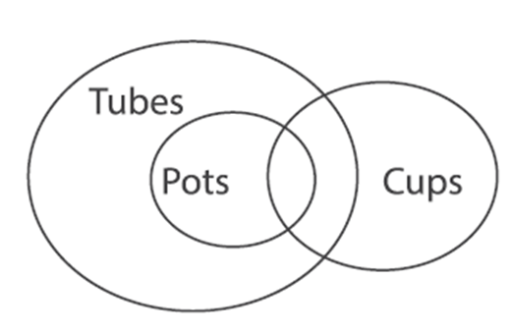
Statements: Some cups are pots.
All pots are tubes.
Conclusions:
I. Some pots are cups.
II. Some tubes are cups.
if only conclusion I follows.
if only conclusion II follows.
if both conclusions I & II follow.
if no conclusion follows.
Ans: 3

Slide 15
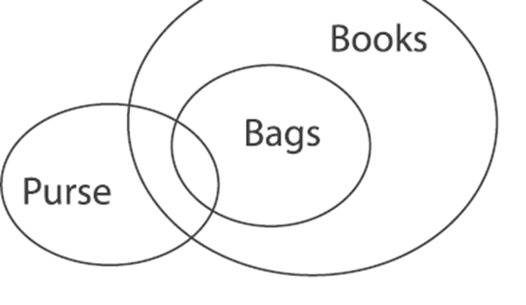
Statements: All bags are books.
Some purses are bags.
Conclusions:
I. Some books are purses.
II. Some books are bags
if only conclusion I follows.
if only conclusion II follows.
if both conclusions I & II follow.
if no conclusion follows.
Ans: 3

Slide 16
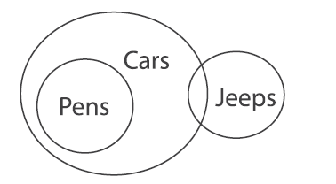
Statements: Some cars are jeeps.
All pens are cars.
Conclusions:
I. No pen is jeep
II. Some jeeps are cars.
if only conclusion I follows.
if only conclusion II follows.
if both conclusions I & II follow.
if no conclusion follows.
Ans: 2

Slide 17
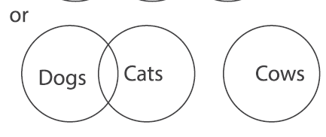
Statements: Some cats are dogs.
No dog is cow.
Conclusions:
I. No cow is cat.
II. No dog is cat.
if only conclusion I follows.
if only conclusion II follows.
if both conclusions I & II follow.
if no conclusion follows.
Ans: 4

Slide 18
Statement: i) Some cats are white. ii) All white are dog. iii) No dog is snow. Conclusion: i) No cats are dogs. ii) Some cats are dogs. iii) No White is Snow.
if only conclusion I and II follows.
if only conclusion II and III follows.
if both conclusions I & II follow.
if no conclusion follows.
Ans: 2
Statement one and two both are positive, so conclusion must be positive. Now, from given conclusion we can see that conclusion one is not at all correct because it is negative. Now, in conclusion two we can say that it might be correct because conclusion is positive but we have to solve it for knowing correct conclusion.

Slide 19
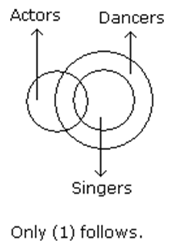
Statements: Some actors are singers. All the singers are dancers.
Conclusions:
Some actors are dancers.
No singer is actor.
A.Only (1) conclusion follows
B.Only (2) conclusion follows
C.Either (1) or (2) follows
D.Neither (1) nor (2) follows
E.Both (1) and (2) follow
Ans:A

Slide 20
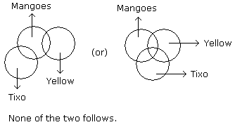
Statements: Some mangoes are yellow. Some tixo are mangoes.
Conclusions:
Some mangoes are green.
Tixo is a yellow.
A.Only (1) conclusion follows
B.Only (2) conclusion follows
C.Either (1) or (2) follows
D.Neither (1) nor (2) follows
E.Both (1) and (2) follow
Ans:D

Slide 21
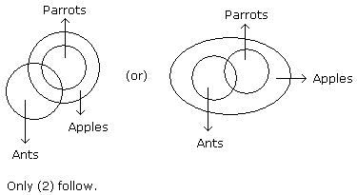
Statements: Some ants are parrots. All the parrots are apples.
Conclusions:
All the apples are parrots.
Some ants are apples.
A.Only (1) conclusion follows
B.Only (2) conclusion follows
C.Either (1) or (2) follows
D.Neither (1) nor (2) follows
E.Both (1) and (2) follow
Ans:B

Slide 22
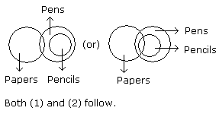
Statements: Some papers are pens. All the pencils are pens.
Conclusions:
Some pens are pencils.
Some pens are papers.
A.Only (1) conclusion follows
B.Only (2) conclusion follows
C.Either (1) or (2) follows
D.Neither (1) nor (2) follows
E.Both (1) and (2) follow
Ans:E

Slide 23
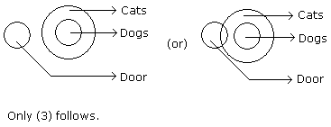
Statements: No door is dog. All the dogs are cats.
Conclusions:
No door is cat.
No cat is door.
Some cats are dogs.
All the cats are dogs.
A. Only (2) and (4)
B. Only (1) and (3)
C. Only (3) and (4)
D. Only (3)
E. All the four
Answer: Option D

Slide 24
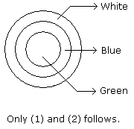
Statements: All green are blue. All blue are white.
Conclusions:
Some blue are green.
Some white are green.
Some green are not white.
All white are blue.
A.Only (1) and (2)
B.Only (1) and (3)
C.Only (1) and (4)
D.Only (2) and (4)
Answer: Option A

Slide 25
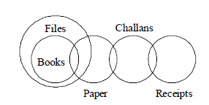
Statements:
Some receipts are challans. Some challans are papers. Some papers are books. All books are files.
Conclusions:
Some papers are files.
Some books are receipts.
No book is receipt.
Only I follows
Only I and II follow
Only I & either II or III follow
Only I and III follow
Ans. (C)

Slide 26
Concept-5 Either & OR Conditions
Two Conclusion
Individual statement wrong.
One positive other negative.
Subject and Predicate either should be same or replaceable to each other.
Note- There should be at least one particular statement.
Note- You can also do with common sense.

Slide 27
Statement: All radios are pencils Some pencils are files Conclusion: I. No radio is file II. Some files are radio A) Only I follows B) Only II follows C) Either I or II follows D) Neither I nor II follows E) Both I and II follows
Ans. (C)

Slide 28
Statements: Some diggers are jokers All jokers are cute. Conclusion: I. Some diggers are cute. II. No diggers are cute. III. Some diggers are not cute IV. All diggers are cute. A) I and III follows B) Either II or IV follows C) II and either III or IV follows D) Either III or IV and I follows E) Either I or II and either III and IV follows
Ans. (D)

Slide 29
Statements: Some bags are pockets. No pocket is a pouch.
Conclusions:
No bag is a pouch.
Some bags are not pouches.
Some pockets are bags.
No pocket is a bag. A) either I or IV follows B) II & III follow C) I & III follow D) All follow
Ans. (B)

Slide 30
Statements: All cones are cylinders. Some cones are squares. No square is a rectangle. Conclusions: I. At least some cones being rectangle is a possibility. II. Some cylinders are cones. A) only I follows B) only II follows C) either I or II follows D) neither I nor II follow E) both I and II follow
Ans. (E)

Slide 31
Concept 6 – All A is B.
There are 2 possible case.
All B are A is Being possible.
Some B are not A is being possible.

Slide 32
Concept 7- Some A are B.
There are 4 possible case.
All A are B is possibility.
All B are A is possibility.
Some A are not B is possibility.
Some B are not A is possibility.

Slide 33
Concept-8 No A is B.
There are no possible case.

Slide 34
Concept- 9 Some A are not B.
There are 6 possible case
No A is B is possibility.
No B is A is possibility.
Some A is B is possibility.
Some B is A is possibility.
Some B are not A is possibility.
All B are A is possibility.
All A are B is possibility.

Slide 35
Statements- All B are A. All A are C. Some C are D. No D is G. Some G are X.
Conclusions-
Some A are D is possibility.
Some B are D is possibility.
All C are G is possibility.
All X are A is possibility.
No G is D is possibility.
I & II follows (b) I, II & IV follows
(c) I, II & V follows (d) I, II, IV & V follows
Ans. (b)

Slide 36
Statements:
Some cups are not bolts.
All dusters are balls.
All cups are balls.
Conclusions:
I. All bolts are cups.
II. Some dusters are cups is a possibility.
A) Only I follows B) Only II follows C) Either I or II follows D) Neither I nor II follows E) Both I and II follows
Ans. (B)

Slide 37
Statements:
All marks are grades.
No grade is a score.
All scores are letters.
Some letters are characters.
Conclusions:
I. Some scores are characters.
II. All marks being letters is a possibility.
III. All characters are grades is a possibility.
A) Only II follows B) Only II and III follows C) All follows D) Only I nor III follows E) None of these
Ans. (B)

Slide 38
Statements:
No cat is rat.
All rats are dog.
Some dog are lion.
Conclusions:
I. No cat is lion.
II. No dog is a rat.
III. Some dog is rat is a possibility.
IV. At least some lions are cat.
A) Either 1 or 2 and 3 follows B) Either 1 or 4 follow C) Either 1 or 4 and 3 follow D) All follows E) None of these
Ans. (B)

Slide 39
Question below contains two conclusions followed by statements. Find from which of the statements given, both the conclusions follow.
Conclusions:
I. Some Red is Blue
II. Some Blue is Black
Statements:
A) All Red is yellow. All Yellow is Black. Some Black is Blue. B) All Red is Yellow. Some Yellow is Black. All Black is Blue. C) No Red is Yellow. All Yellow is Black. Some Black is Blue. D) Some Red is Yellow. All Yellow is Black. No Black is Blue. E) None of these
Ans. (E)

Slide 40
Question below contains two conclusions followed by statements. Find from which of the statements given, both the conclusions follow.
Conclusions:
I. Some Oranges are not Kiwis
II. Some Apples are not Bananas
Statements:
A) Some Kiwis are Apples. No Apple is Orange. All Orange are Bananas. B) All Kiwis are Apples. Some Apples are Oranges. All Oranges are Bananas. C) No Kiwi is Apple. All Apples are Oranges. No Orange is Banana. D) No Kiwi is Apple. No Apple is Orange. All Oranges are Bananas. E) None of these
Ans. (C)

Slide 41
Statements:
Some Rubber are Pen.
All Pen are Pencil.
All Rubber are scale.
Conclusions:
I. Some Rubber being Pencil is a possibility.
II. Some Scale being Pen is a possibility.
If only conclusion I follows
If only conclusion II follows
If either conclusion I or conclusion II follows
If neither conclusion I nor conclusion II follows
If both conclusion I and conclusion II follow
Ans. (d)

Slide 42
Statements:
All violet are green.
All yellow are orange.
Some violet are orange.
No yellow is violet.
Conclusions:
I. All orange can be violet.
II. All green being yellow is a possibility.
If only conclusion I follows
If only conclusion II follows
If either conclusion I or conclusion II follows
If neither conclusion I nor conclusion II follows
If both conclusion I and conclusion II follow
Ans. (d)

Slide 43
Statements:
All Bag is Pouch.
Some Bag is Curtain.
No Curtain is Cloth.
Some Pouch is Floor.
Conclusions:
I. Some Pouch are not Cloth.
II. All Floor can be Curtain.
III. All Pouch are Bag.
IV. Some Cloth can be Pouch.
None follows
Only I, II and IV follow
Only III follows
Only II & III follow
None of these
Ans. (b)

